Slide 1
Netscaler and Networking in CloudStack
Deepak Garg
Citrix R&D, Bengaluru
Netscaler and Networking in CloudStack by Deepak Garg is licensed under a Creative Commons Attribution-NonCommercial-NoDerivs 3.0 Unported LicenseBased on a work at github.com.

Slide 2
Contents
LB
App Delivery Controllers
Netscaler ?
Netscaler Features
NS and HTTP
NS IPs
Operational Modes – VServer, Transparent mode
NS Monitors
LB Algos
CloudStack – Networking Offering
CloudStack – Advanced Networking
HAProxy – LB with Virtual Router
SSL-Offloading with Netscaler

Slide 3
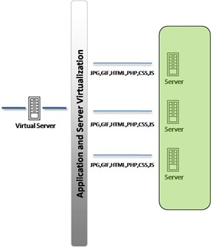
LB
balancing load (application requests) across a number of servers based on a load-balancing algo
Algos:
  Round-robin
  weighted round-robin
  least connections
  weighted least connections
Needs exactly same content across all servers

Slide 4
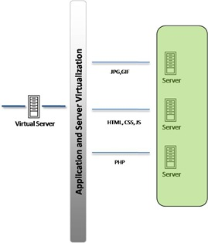
App Delivery Controllers
Layer 7 switching aka "application switching" aka "content based routing" aka "request switching"
Look into the request packet and takes decission

Slide 5
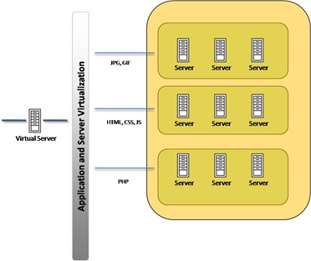
App Delivery Controllers
The backend server content may not be the same
Each fleet of servers may be specialized for particular tasks

Slide 6
Netscaler
L4 – L7 Switch => application aware switch
Patented Request Switching™ technology
  Terminates client connections and then establishes proxy connections, or reuses existing connections with the servers
  Talks HTTP, SSL, FTP, TCP, UDP, RDP etc...
  Application Switching
  Application Acceleration / Optimization
  Application Security / Access
  Enhanced application security beyond perimeter defenses

Slide 7
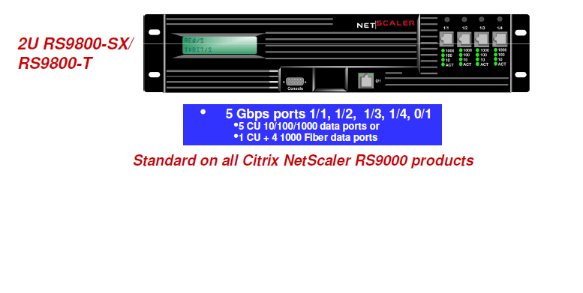
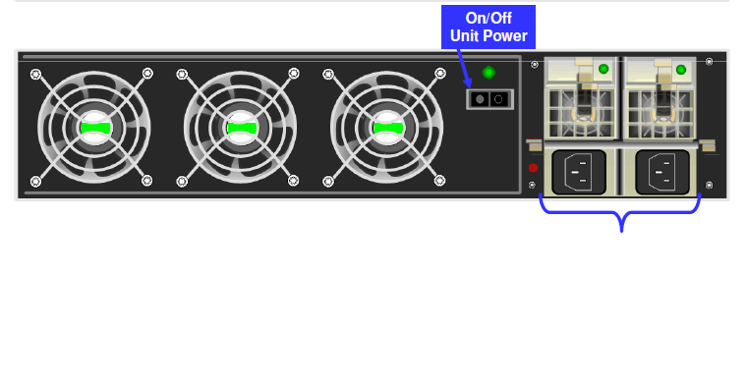
NetScaler
Ships as MPX, SDX and VPX

Slide 8
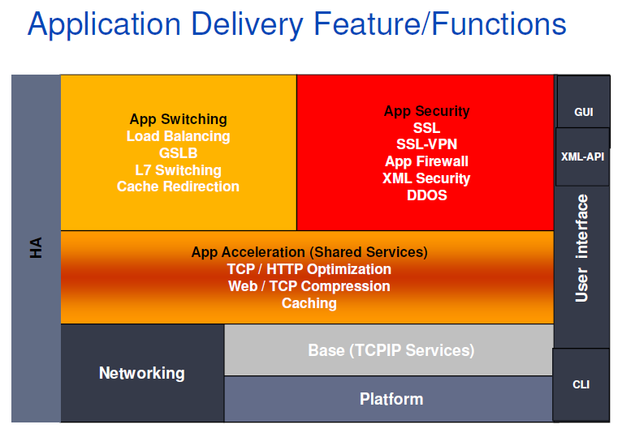
NS Features

Slide 9
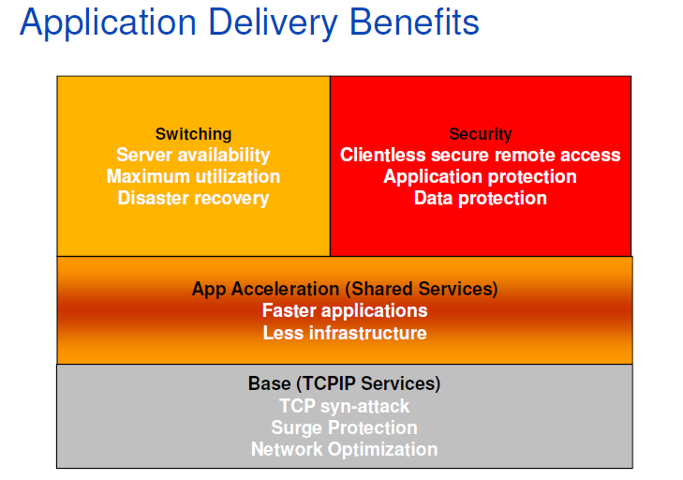
NS Features

Slide 10
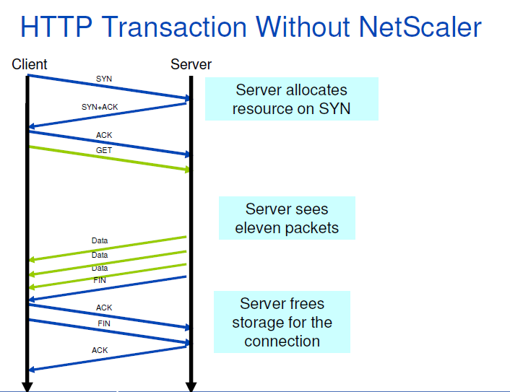
NS and HTTP

Slide 11
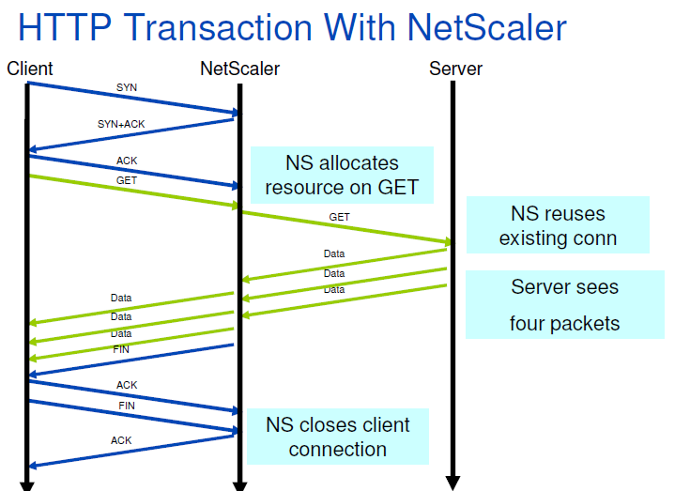
NS and HTTP

Slide 12
Connection Multiplexing
Multiple clients use single connection to server - Sequentially, not simultaneously!
Benefits:
  Optimal reuse of each server connection
    Slowstart vs. Fast Ramp
  Optimal use of each client connection
    HTTP/1.1
    Client Keep-Alive
Requires TCP connection manipulation
  Connection Proxy
  Connection Termination

Slide 13
NetScaler Owned IPs
NSIP = NetScaler IP
  Unique management IP for the NetScaler system.
MIP = Mapped IP(s)
  Default set of addresses to communicate with back end servers.
SNIP = Subnet IP
  IP for communication to servers/clients in other subnets/vlans
VIPs = Virtual IPs
  Normal method for configuring explicit services

Slide 14
Operational Modes
VServer proxy mode ~ Reverse Proxy
Transparent mode ~ Forward Proxy

Slide 15
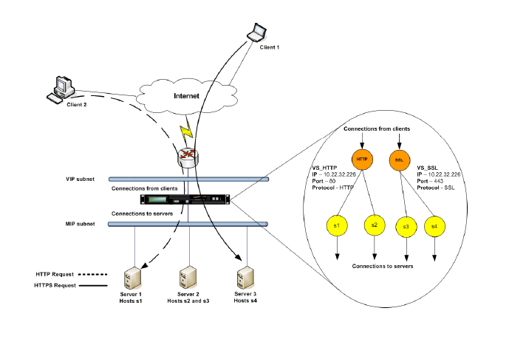
NS Virtual Entities

Slide 16
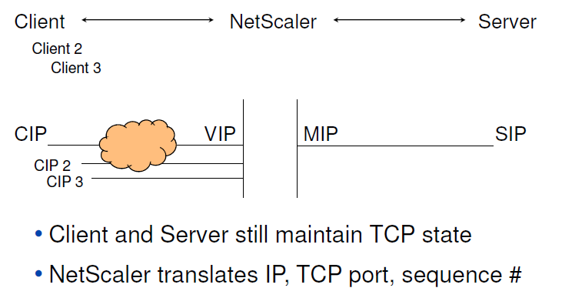
VServer (Proxy) Mode

Slide 17
Vserver (Proxy) Mode ...
A VIP represents a collection of servers to a client
  For any given transaction the VIP is mapped into a single server IP
  Usually clients don’t need to know the true server IP address
A MIP represents a collection of clients to a server
  For any given transaction the MIP is mapped into a single client IP
  Usually servers don’t need to know the true client IP address
  Options exist for those servers which do need to know
    enable ns mode USIP

Slide 18
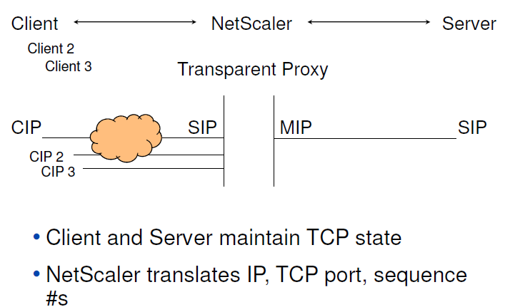
Transparent Mode

Slide 19
Transparent Mode ...
Original NetScaler functionality
Does not require extensive configuration
Full Traffic Optimization and Traffic Security Feature Sets
  IP address and port mapping
  Attack prevention
  Content Filtering
  SSL offload
  Compression
  Caching
SSL Offload and Compression require full connection termination
  No additional configuration of TCP functionality required

Slide 20
NetScaler Monitors
Monitor the backend servers
  Simple ping
  Tcp syn/ack
  App aware monitor
    If the web server delivers 404
    If the db can execute the query
    Take actions based on results
Timeouts for the monitor
If Monitor says 'No', bring down the server from the LB list
Make a custom monitor !!

Slide 21
LB Algos
Round Robin
Least Connection (default)
  Keeps connection pools
  active connections opened to any backend server
Least Response
  Avg. Response time calculated real-time
  Time to first byte
Least BandWidth
Token LB
Etc. (source ip, URL hashing, domain hashing)

Slide 22
CloudStack Nw Services & Providers
Networking Mode | Network Services | Service Providers
Basic Networking | DHCP (only Virtual Router) NAT (only NetScaler) LB (only NetScaler) | Virtual Router Netscaler
Advanced Networking | DNS DHCP LB FireWall Port Forwarding NAT VPN | Virtual Router Netscaler F5 SRX

Slide 23
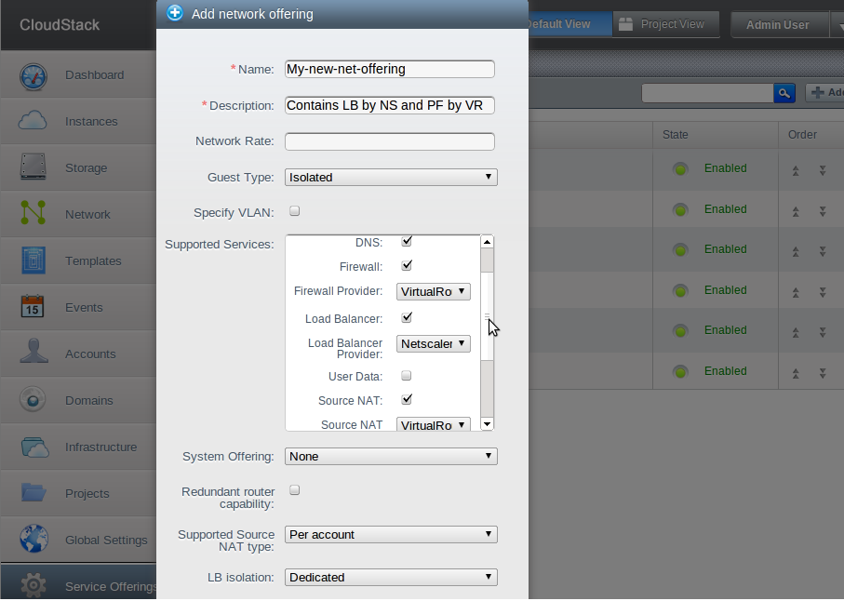
CloudStack Nw Offering

Slide 24
CloudStack – Advanced Nw
Private Nw
Public Nw
Guest Nw
CLOUDSTACK
MANAGEMENT
SERVER
XS
VM
VM
NFS
NetScaler
SS VM
Console
Proxy
Virtual
Router

Slide 25
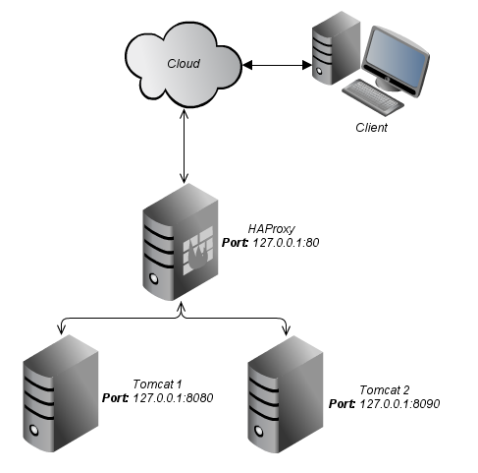
LB with Virtual Router
HAProxy - High Availability Proxy
Software LB
Features
  Talks TCP and HTTP
  /etc/haproxy/haproxy.cfg
  active/passive configuration

Slide 26
CloudStack – Netscaler Demo....

Slide 27
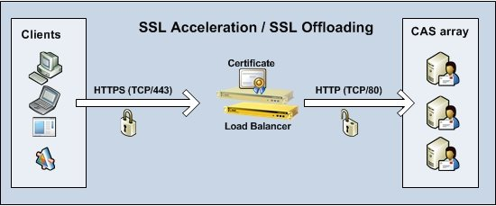
SSL-Offload with NetScaler
Modes:
  ssl-http
  ssl-ssl
  http-ssl (never used)

Slide 28
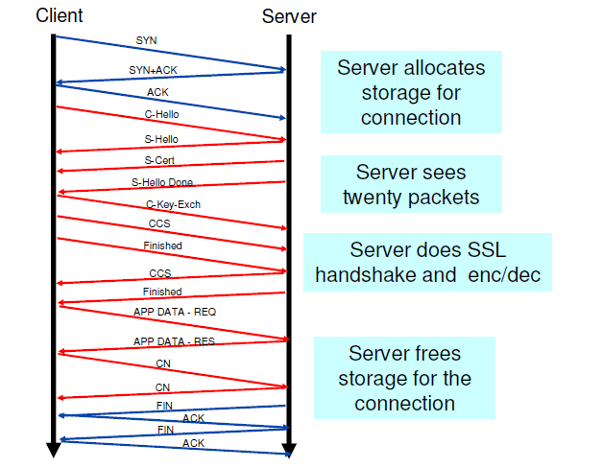
SSL Transaction Without NetScaler

Slide 29
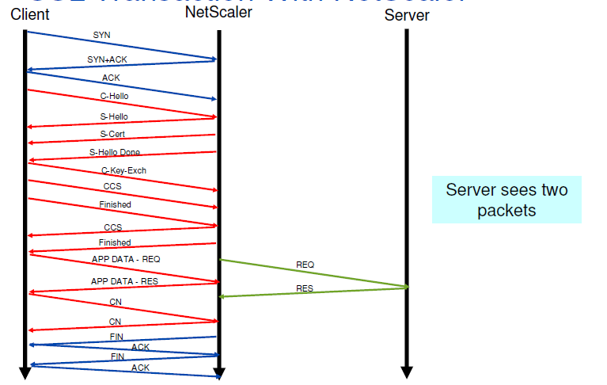
SSL Transaction With NetScaler

Slide 30
  Thanks,
  Deepak Garg
  deepak.garg@citrix.com
  deepakgarg.iitg@gmail.com
  @donji

